Slide 1
Auditor Calibration on L2 competence auditing
Presented Auditor calibration meeting Sept 4 2013

Slide 2
Objective
To have a unified approach to auditing L2 Competence using 00-OP-S0075

Slide 3
Requirement
QUALIFICATION PROCESS
FOR CAS EVALUATION (L2) STAFF
00-OP-S0075
And
00-CE-P0001

Slide 4
11.3 Records Locations & Details
Record ID | System | Access/Retrieval | Protection | Min. Retention Time | Disposition
Qualification Records Candidate Qualifications & Applicable Training Records | Learning Management System (LMS) Knowledge Management System KMS Community | Via UL network access | Via UL network | 7 Years after employee leaves UL | Delete
Technical Competency Records | TCD | TCD | TCD | 7 Years after employee leaves UL | Delete

Slide 5
12.0 Standard e-mail Communication
After the Candidate’s Mentor has reviewed the Candidates performance as indicated in ‎9.5.1 and has determined that the Candidate has successfully completed all the training and assessment requirements, the Mentor sends an e-mail that contains this information to the Candidate and the Candidate’s Supervisor:

Slide 6
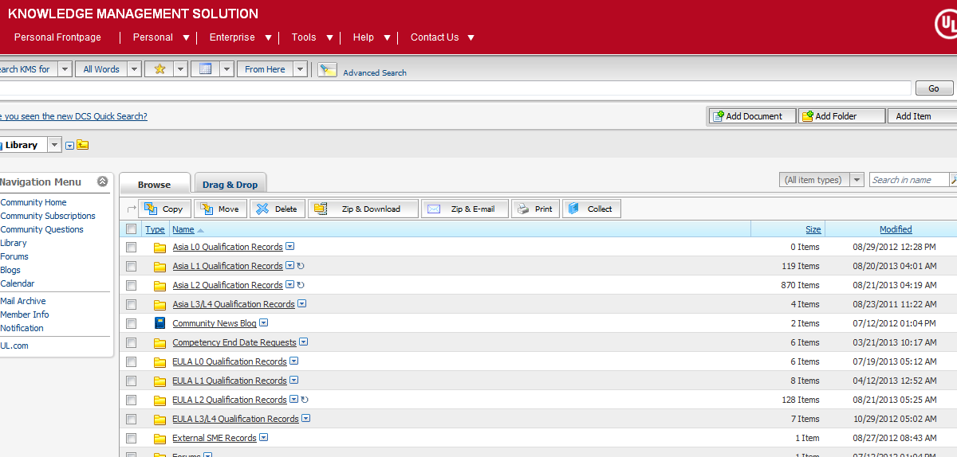

Slide 7
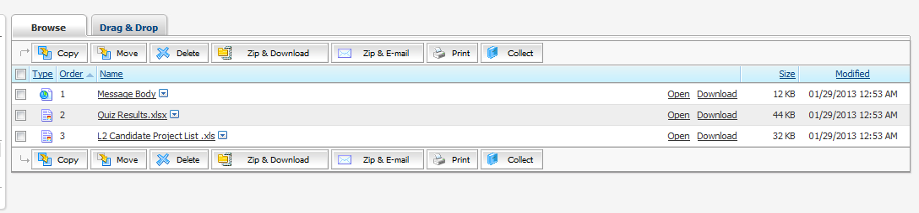
Notes:
What you might find in KMS for an individual

Slide 8
Where in KMS are these records?
http://kms.ul.com/km/llisapi.dll?func=ll&objId=827885&objAction=browse&sort=name

Slide 9
Moving forward
We should sample these records as well as checking for the competence in the TC Data base
Some of have been doing this for the past 2 years but most of us, myself included have not

Slide 10
End

